Slide 1




NEXT GEN EMPLOYABILITY PROGRAM
Creating a future-ready workforce
Team Members
College Name
Student Name : JAYABHARATHI M
Student ID : au620321104037
BHARATHIYAR INSTITUTE OF ENGINEERING FOR WOMEN

Slide 2

CAPSTONE PROJECT SHOWCASE
Project Title
Building Bus Reservation System using Python and Django
Abstract | Problem Statement | Project Overview | Proposed Solution | Technology Used | Modelling & Results | Conclusion

Slide 3
Abstract
This project aims to develop a comprehensive Bus Reservation System using Python programming language and Django web framework. The system is designed to streamline the process of booking bus tickets, managing routes, schedules, and passenger information.
The proposed system will offer various functionalities including user registration and authentication, searching for available buses based on departure and destination locations, selecting seats, making reservations, and processing payments securely.
Key features of the system will include an intuitive user interface for both passengers and administrators, real-time updates on seat availability, flexible booking options, and integration with payment gateways for secure transactions. Additionally, administrators will have access to a dashboard to manage bus routes, schedules, fares, and view booking details.
The development process will involve implementing a Model-View-Controller (MVC) architecture using Django, incorporating database models to store information such as bus details, schedules, reservations, and user data. Python libraries will be utilized for functionalities such as data validation, authentication, and handling payments.
The project aims to deliver a scalable, efficient, and user-friendly Bus Reservation System that enhances the overall experience of both passengers and administrators. By leveraging the capabilities of Python and Django, the system will provide a robust solution for managing bus reservations, thereby optimizing the operations of bus companies and improving customer satisfaction.
Source :

Slide 4
Problem Statement
The existing bus reservation systems lack the efficiency and user-friendliness required to meet the evolving needs of passengers and bus operators. Some of the key challenges faced by both passengers and bus companies include:
Manual Booking Processes: Traditional bus reservation systems rely heavily on manual processes for ticket booking, seat allocation, and payment processing. This leads to inefficiencies, long waiting times, and potential errors in reservation management.
Limited Accessibility: Many existing reservation systems are not easily accessible to passengers, particularly those in remote areas or with limited internet connectivity. This limits the convenience and reach of bus services, affecting passenger satisfaction and revenue generation for bus companies.
Lack of Real-time Information: Passengers often struggle to obtain real-time information about bus schedules, seat availability, and fares, leading to uncertainties and inconvenience during the booking process.
Inefficient Management: Bus companies face challenges in managing routes, schedules, seat occupancy, and customer data using outdated or fragmented systems. This results in suboptimal resource utilization, revenue loss, and operational inefficiencies.
Security Concerns: Security of passenger data and payment transactions is a critical aspect of bus reservation systems. Existing systems may lack robust security measures, making them vulnerable to data breaches and fraudulent activities.
Solution Approach: To address the aforementioned challenges, the proposed solution involves developing a Bus Reservation System using Python programming language and Django web framework. The system will offer the following features and functionalities:
User-friendly Interface.
Real-time Updates.
Admin Dashboard.
Secure Transactions.
Scalability and Customization.
Source :

Slide 5
Project Overview
The Bus Reservation System project aims to create an efficient and user-friendly platform for passengers to book bus tickets and for administrators to manage bus schedules, routes, and reservations.
Key Objectives:
Develop a web-based platform accessible to both passengers and administrators.
Implement features for passengers to search for buses, select seats, make reservations, and complete payments securely.
Create an administrative dashboard for bus company staff to manage routes, schedules, fares, and bookings.
Technologies Used:
Python: Utilized as the primary programming language for backend development.
Django: Employed as the web framework for rapid development.
Deployment: Deploy the application on a web server using platforms like Heroku, AWS, or DigitalOcean.
Project Phases:
Requirements Gathering.
System Design.
Implementation.
Testing.
Deployment.
Maintenance and Support.
Source :

Slide 6
Proposed Solution
The proposed solution aims to develop a comprehensive Bus Reservation System using the Python programming language and Django web framework. This solution addresses the challenges faced by both passengers and bus companies in the existing reservation systems by offering a user-friendly interface, real-time updates, efficient management tools, and robust security measures.
Key Features:
User Authentication and Authorization : Implement user authentication and authorization mechanisms to ensure secure access to the system for passengers and administrators.
Bus Search and Booking : Develop a search functionality for passengers to find buses based on departure and destination locations, dates, and other preferences . Enable passengers to view bus schedules, seat availability, fares, and other relevant information.
Source :

Slide 7
3.Administrative Dashboard : Create a dashboard interface for bus company administrators to manage routes, schedules, fares, and bookings . Provide functionalities to add, edit, or delete bus routes, update schedules, set fares, and view booking details.
4..Real-time Updates and Notifications : Integrate real-time data feeds to provide passengers with live updates on bus availability, schedules, seat occupancy, and fare change.
5.Seat selection: Provide an interface for passengers to select their desired seats when making a reservation. Ensure real-time seat availability updates to prevent double bookings.
6.Reservation management: Allow users to book, modify, and cancel reservations. Include features such as viewing reservation history, upcoming trips, and printing tickets.
Source :

Slide 8
7.Payment and integration: Integrate with a payment gateway to facilitate secure online payments for reservations. Support multiple payment methods and ensure PCI compliance.
8.Admin dashboard: Create an admin interface to manage buses, reservations, users, and other system settings. Provide tools for monitoring bookings, generating reports, and resolving disputes.
9.Email notification: Send automated email notifications to users for booking confirmations, reminders, cancellations, and other important updates.
Source :

Slide 9

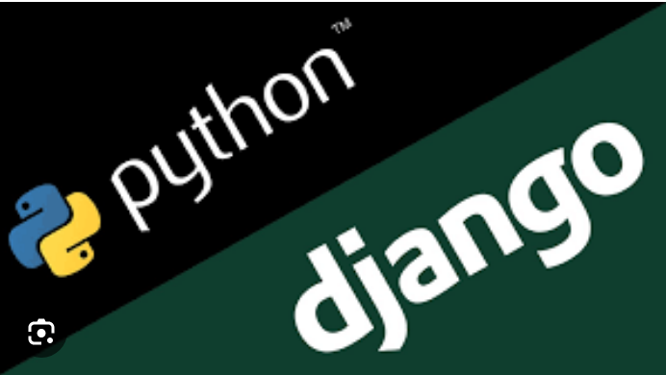
Technology Used
Front-end
Back-end
Source :

Slide 10
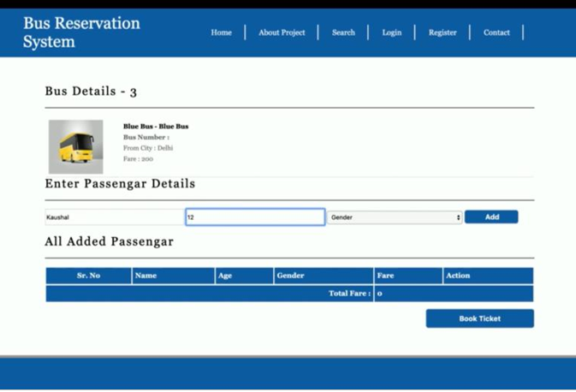
Modelling & Results
MODELLING : Database modelling.
EXPECTING RESULTS :
1)user authentication.
2)view available buses and routes.
3)search functionality.
4)make reservations.
5)view reservations.
6)cancel reservations.
7)admin panels.
8)validation and error handling.
9)payment integration.
10)email notifications.
11)responsive design.
12)security.
Source :

Slide 11
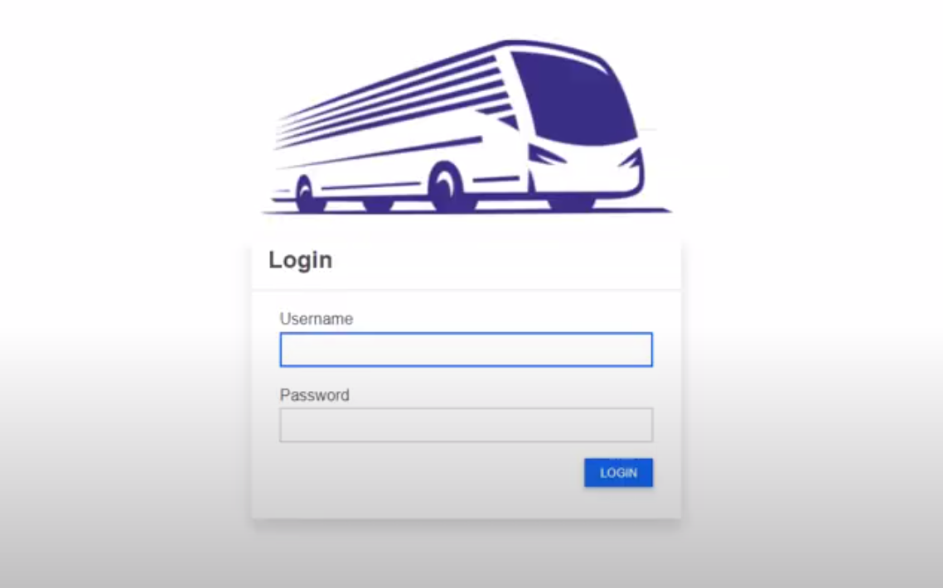
Homepage

Slide 12
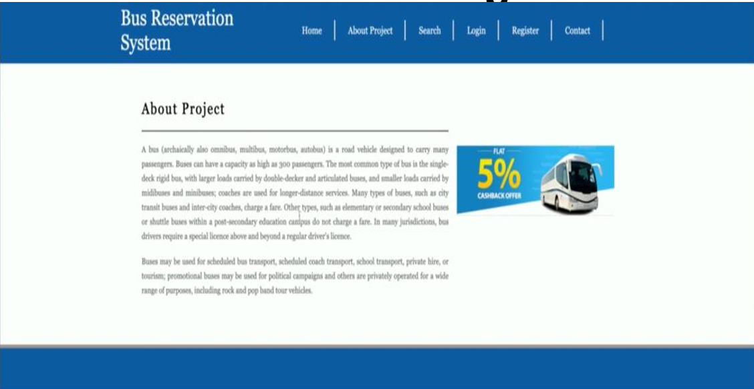
About-Us-Page

Slide 13
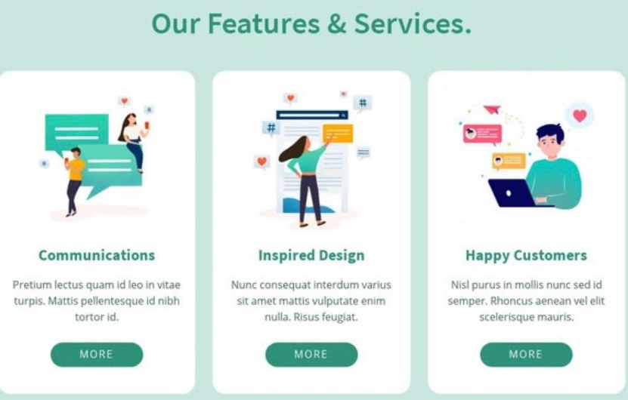
Service-Page

Slide 14
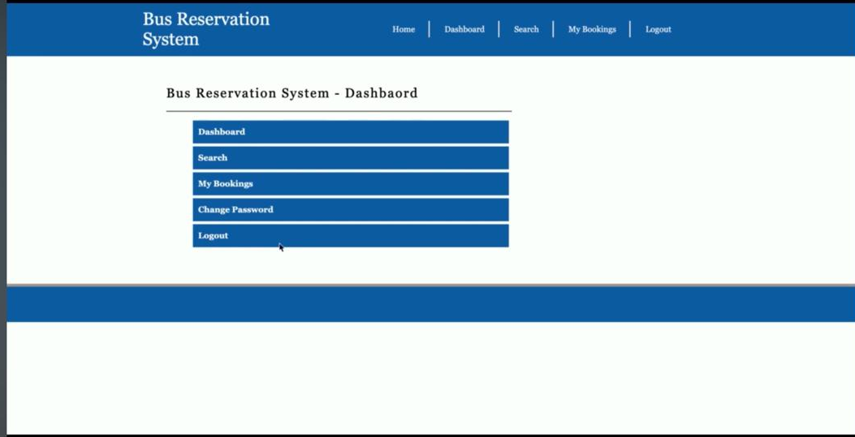
Departments-Page

Slide 15
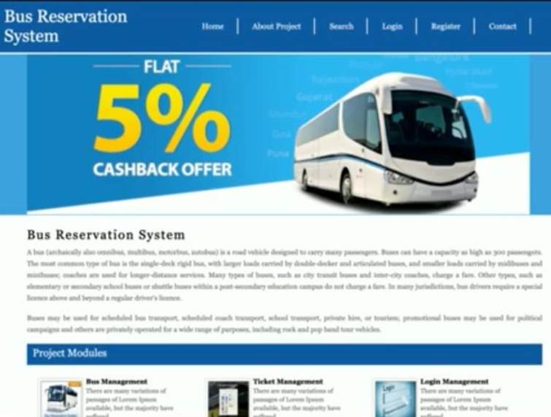
Blog - page

Slide 16
Future Enhancements:
User Reviews and Ratings.
Real-time Bus Tracking.
Dynamic Pricing.
Mobile App Development.
Seat Selection.
Multi-language Support.
Social Media Integration.
Advanced Search and Filtering.
Push Notifications.
Integration with Travel APIs.
Advanced Analytics.
Offline Booking.
Accessibility Features.
Virtual Reality (VR) Tours.
Continuous Performance Optimization.

Slide 17
Conclusion
In conclusion, developing a bus reservation system using Python and Django offers a robust and efficient solution for managing bookings, schedules, and customer interactions within the transportation industry. By leveraging the powerful features of Django, such as its built-in authentication, ORM, and admin interface, developers can streamline the development process and create a scalable and maintainable application.
Through this project, we have demonstrated the ability to create a user-friendly interface for both customers and administrators, allowing for easy booking, cancellation, and management of bus reservations. Additionally, by incorporating features such as real-time seat availability updates and payment processing integration, we have enhanced the overall user experience and operational efficiency of the system.
Furthermore, Python's versatility and extensive ecosystem of libraries make it an ideal choice for implementing various functionalities within the reservation system, such as handling complex business logic, data manipulation, and integration with external services.
Overall, the development of a bus reservation system with Python and Django not only showcases the power and flexibility of these technologies but also addresses the practical needs of the transportation industry, providing a seamless and convenient booking experience for both customers and administrators alike. With continued iteration and improvement, this system has the potential to become a cornerstone in the modernization of bus transportation services.
Source :

Slide 18
Thank You!
Notes:
Thank You !!

